Slide 1
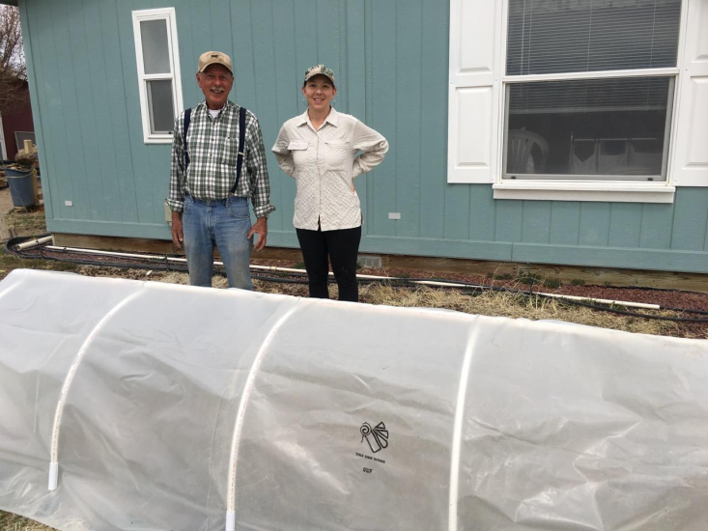
LOW TUNNEL GARDEN STRUCTURES
2018 NEVADA SCHOOL GARDEN CONFERENCE
Presented by Ray Johnson
Custom Gardens Organic Farm - Silver Springs, NV
775-577-2069 customgardens@att.net

Slide 2
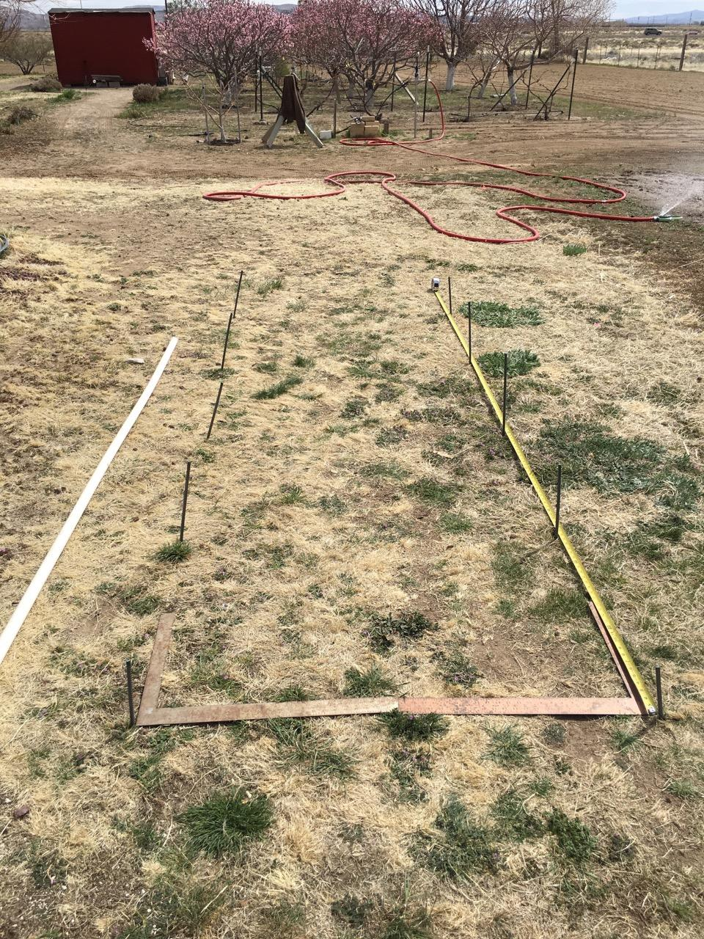
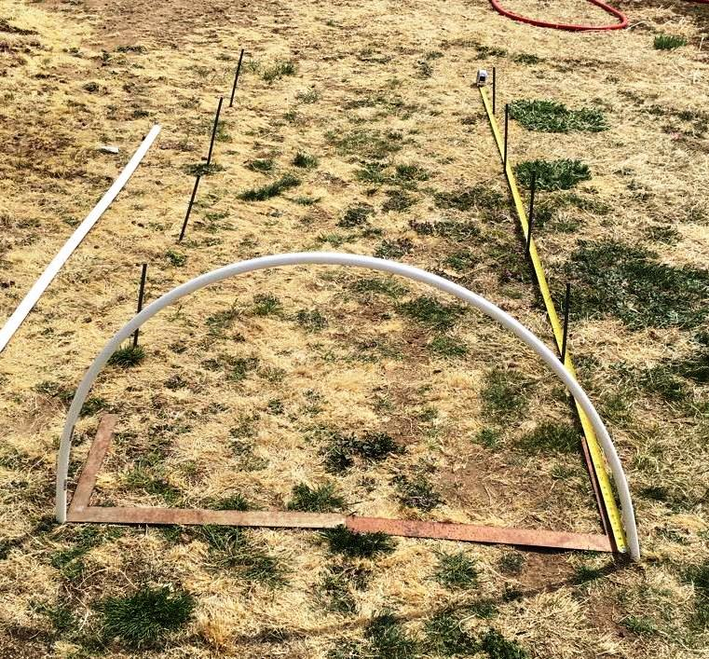
LowTunnel A with Rebar + PVC RIB

Slide 3
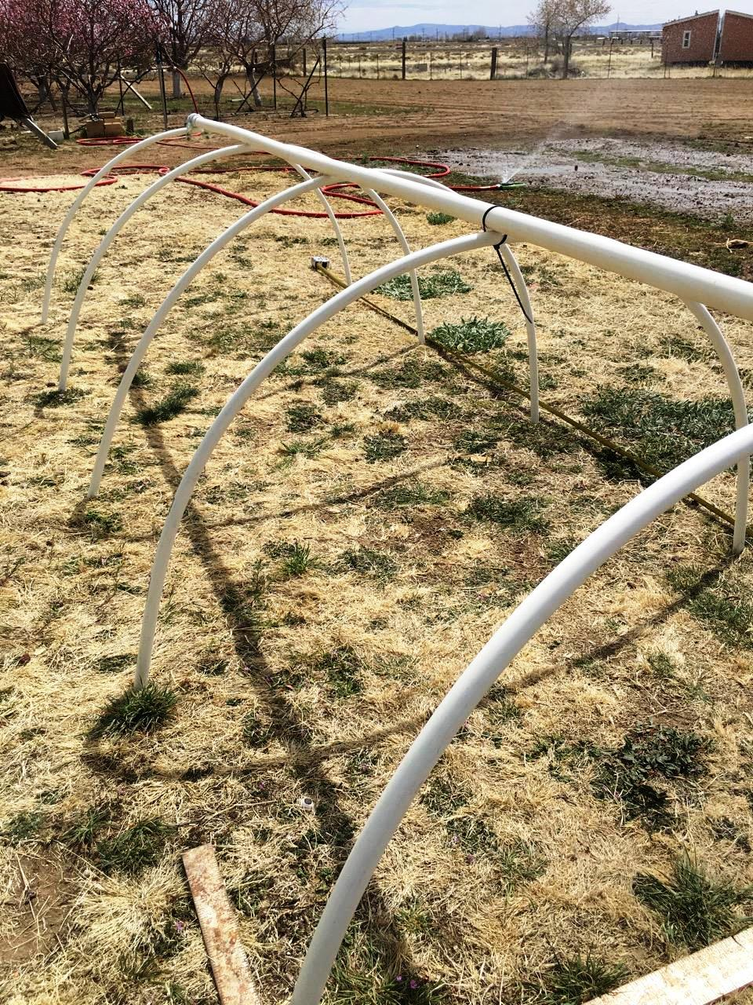
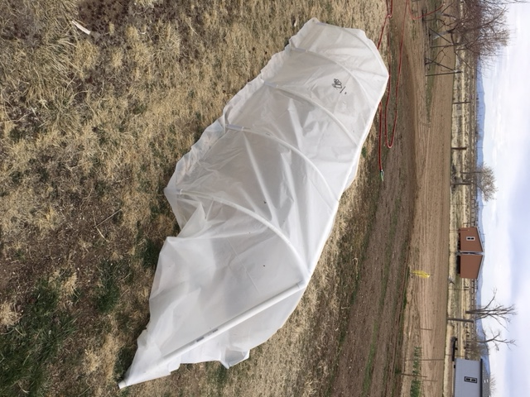
“A” with Ridge-Pole + Finished View

Slide 4
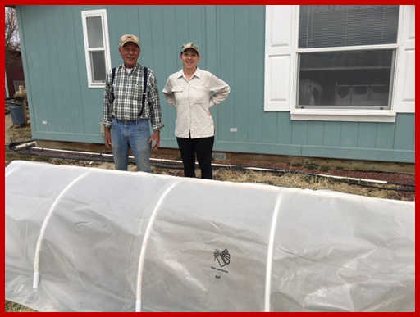
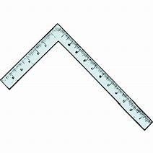
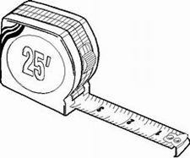
The builders, farmer Ray and volunteer Lizz – work with low tunnels for season extension.

Slide 5
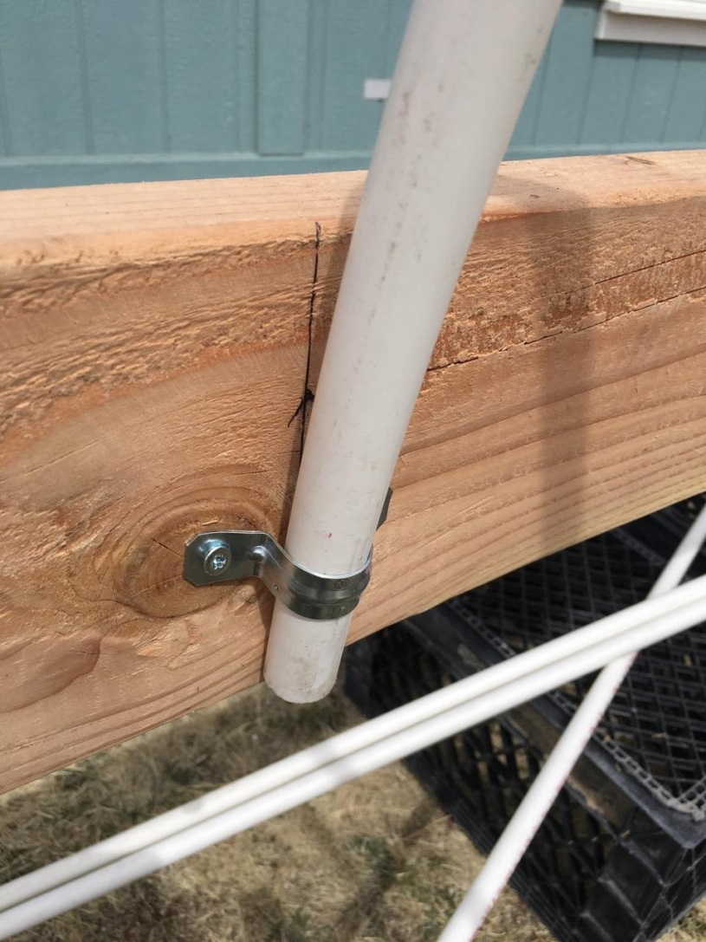
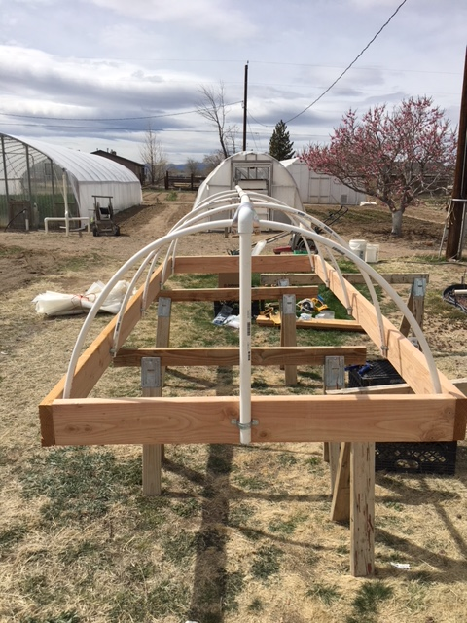
LOW TUNNEL B WITH LUMBER

Slide 6
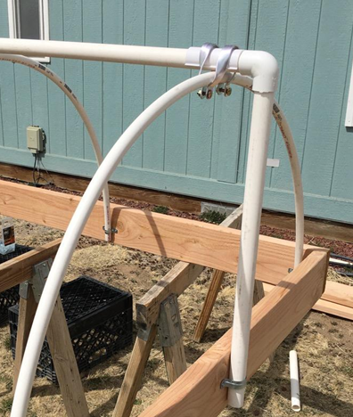
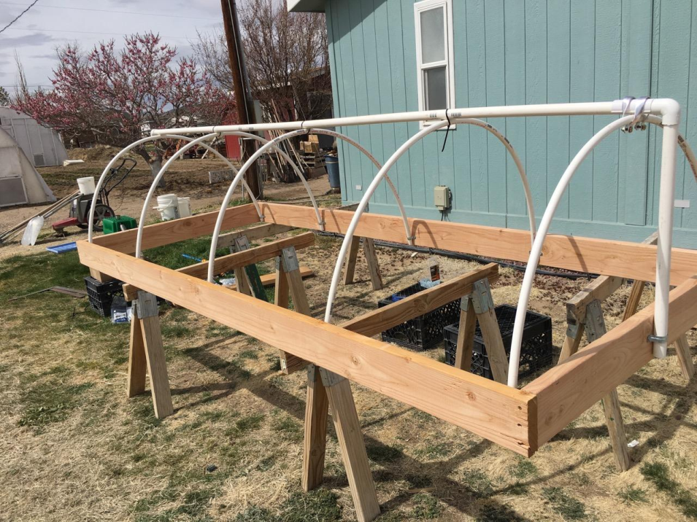
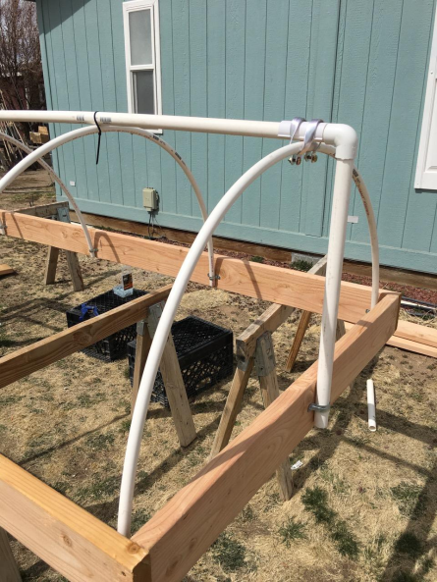
Low Tunnel B close up and finished.
4 X 8 Ft finished Wood Frame, before placement and seasonal cover or shade.

Slide 7
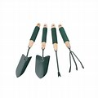
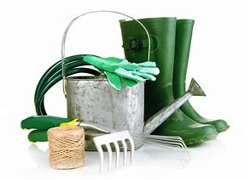
Resources, mail order and Local
Peaceful Valley Farm Supply (seeds, supplies and tools) www.groworganic.com
Johnny’s Seeds (Growers Library, Seed, Supplies, Tools) www.johnnyseeds.com
FarmTek (commercial scale – high tunnel frames and supply. ) www.farmtek.com
Growers Supply (a division of FarmTek) www.growerssupply
Shop Locally wherever possible – Here are some of our area supply businesses:
LOWES, HOME DEPOT, GARDEN CENTERS - IN YOUR COMMUNTY
Remember, even if a big box store, these businesses provide local jobs!

